Slide 1

HOUSING ACROSS THE UNITED STATES

Slide 2
“People I know with houses squeeze every drop of capital out of them, because, even when it's hard, squeezing capital out of a house is a hell of a lot easier than squeezing it out of work.”
― Catrina Davies, Homesick: Why I live in Shed

Slide 3
PROBLEM STATEMENT
Describe and explain the factors that could influence residential home prices across the United States over the next few decade, and how?

Slide 4

Factors That Could Influence Residential Home Prices Across The United States Over The Next Decade

Slide 5
Factors that Influence Prices of residential homes in the United States
1. Demand - The current state of the economy and the amount of available homes.
2. Supply - The number of homes being built, how many of those are on the market and how many are sold in a given timeframe
3. Builder Costs & Profit with Market Competition
4. Income: The average income of people living in a particular area is one of the most defining factors of the prices of homes in that area. Houses around major cities and states where people tend to earn more are usually also costlier than houses in rural areas.
5. Location:
Residential houses are usually more costly where there are
a. Better Employment opportunities
b. More people (High population)
c. Close Malls, Entertainment centers, schools etc.
6. The general condition of the house:
People tend to be willing to pay more for houses that are in better condition. So, little factors like the state of the bulbs, fans, toilets, kitchen and all that can go a long way in determining the value of your house.
7. Number and Sizes of the rooms:
1-bedroom Flats are on average, relatively the costliest flats. After that price of residential apartments rise linearly from two to eight with its peak at eighth then falls back from 9 onwards.
The price of a house tends to increase with the number of bathrooms available. The sweet point is somewhere around 7 bathrooms
Even though people tend to pay more for houses with more floors. They are also other factors that would also affect the price.
Other significant determining variables, such as the area in which the property is located, the interest rates on the mortgage, the state of the economy, The unemployment rate and others, may also have an impact on the price of residential properties.

Slide 6
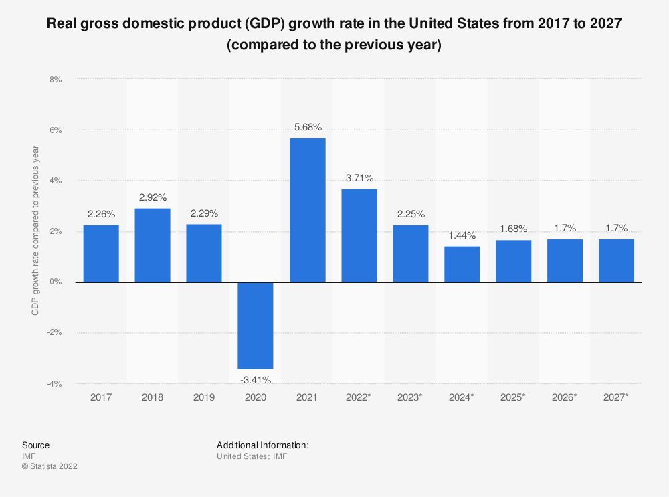
Growth in the Economy:
Housing demand depends on revenue. With higher economic growth and wages, people can spend more on housing, improving applications, and boosting prices. In reality, housing demand is often seen as elastic in terms of income, leading to increased household revenues. In a recession, reduced sales will also stop people from buying, and people who lose their jobs will fall behind their mortgage payments and end up repossessing their homes.

Slide 7

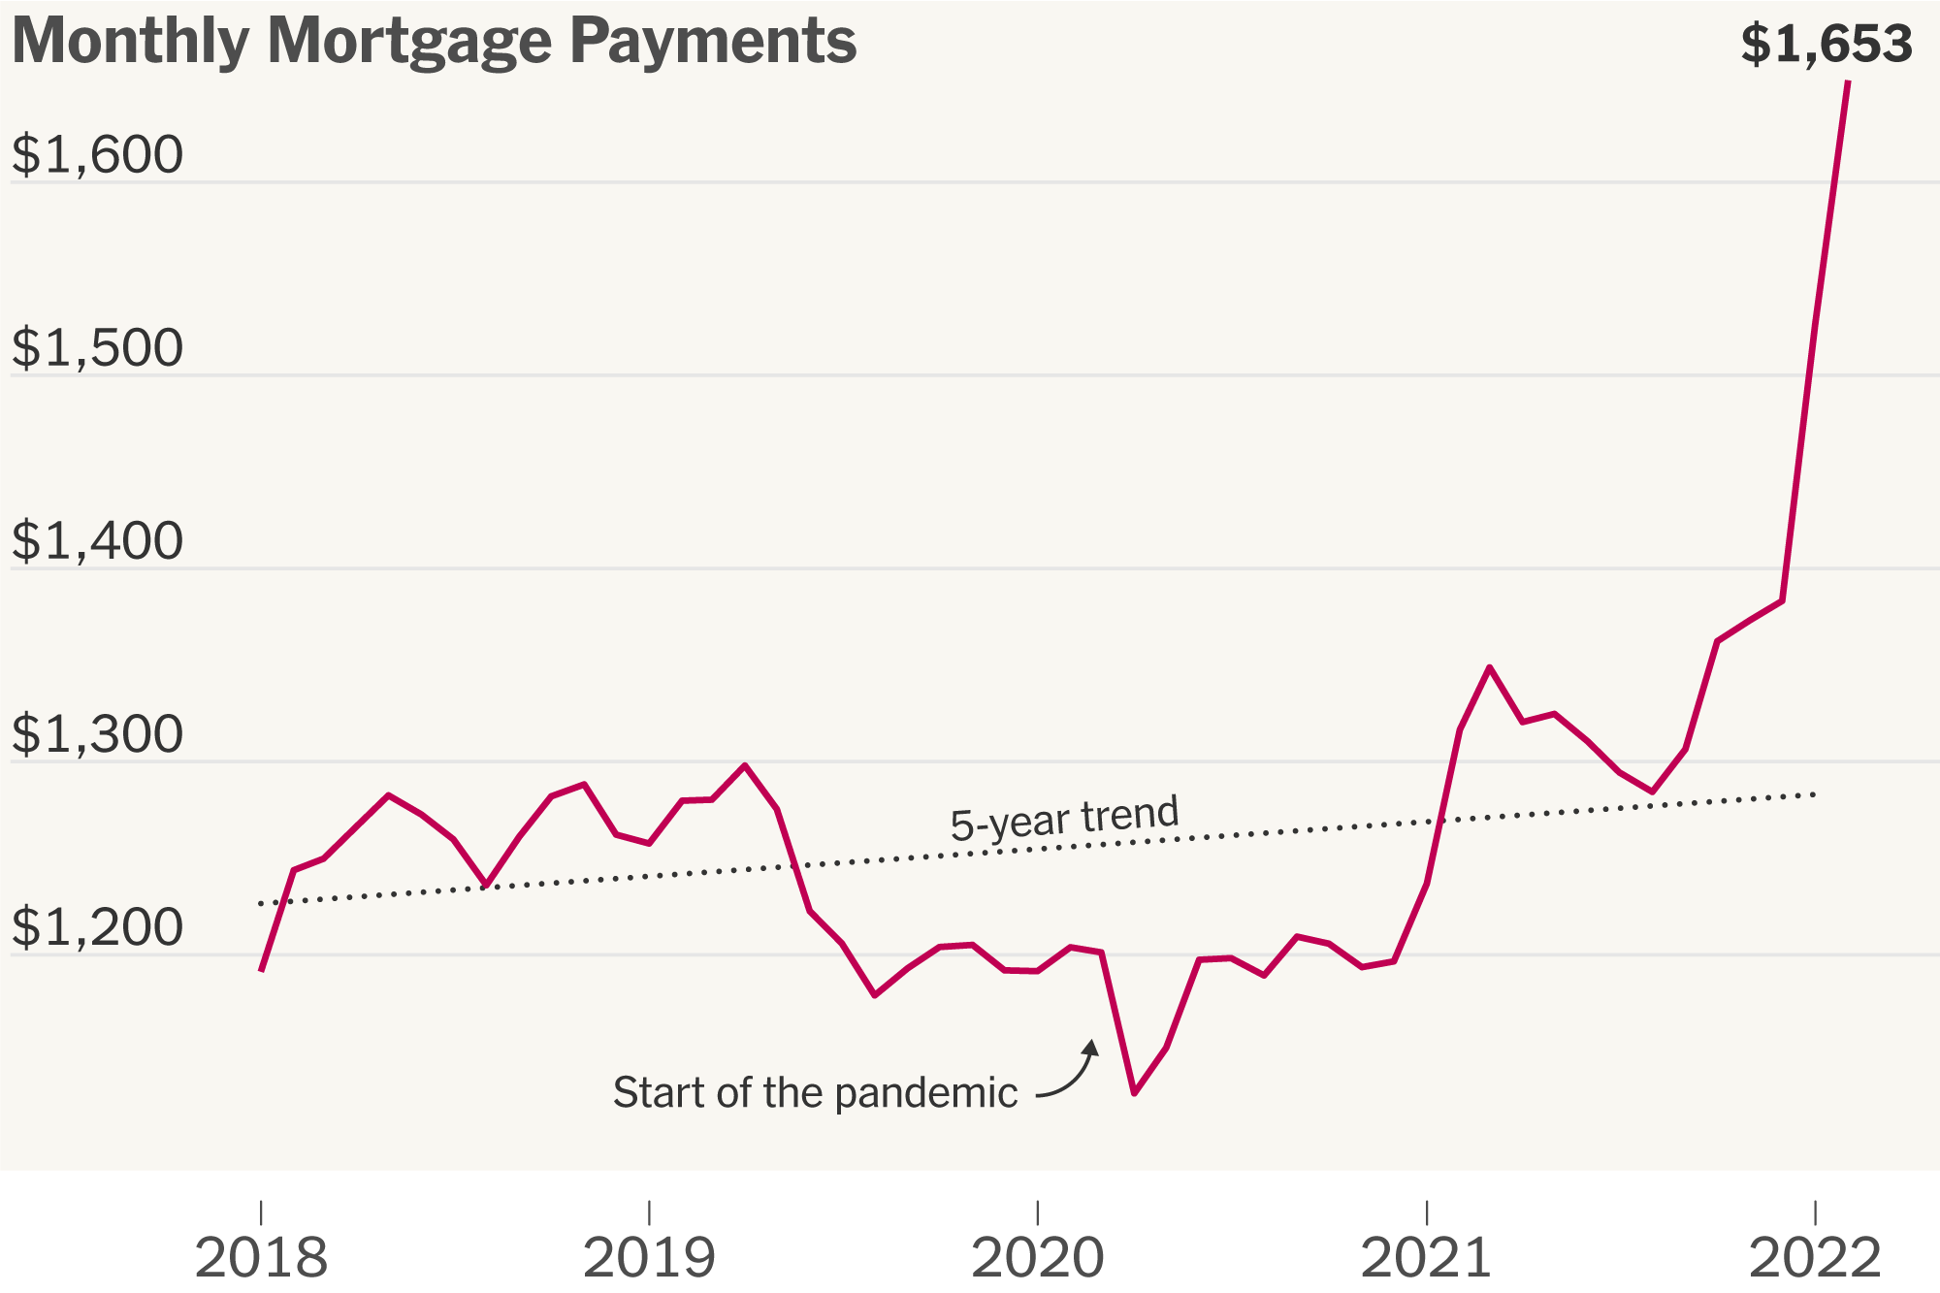
Unemployment:
The second important point that comes under the economic factors affecting the housing market is related to economic growth. Very few people will have possible to afford a house as unemployment rises. But even fear of unemployment can stop people from entering the real estate market.
Mortgage Availability:
Most banks are keen to lend mortgages during the boom years of 1996-2006. It enabled people to borrow large amounts of revenue (for example, five times the income). Additionally, minimal deposits that are 100% of mortgages are provided by banks. The flexibility of hypothecating meant that the housing demand grew as more people could buy now.

Slide 8
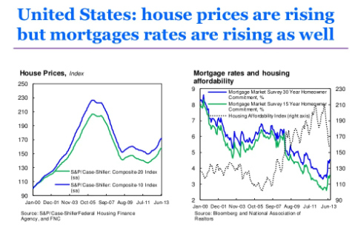
Residential home prices are expected to rise in the United States over the next decade, but it’s not just because of a growing population. The factors that will influence home prices include an aging population, an increasing number of baby boomers retiring and moving into homes that they can no longer afford; rising interest rates; and higher taxes.

Slide 9
On March 5th, 2019, the United States Department of Commerce released a report that analyzed the factors that could influence residential home prices across the country over the next decade.
The report, which was based on data from the Federal Housing Finance Agency (FHFA), found that while housing prices are increasing at a slow rate, there are still many factors that can influence what homebuyers pay for their homes.
The aging population will result in an increase in demand for housing as more people age into their golden years. Many baby boomers are opting to rent rather than buy outright, which is contributing to increased demand for rental properties. Additionally, there are many empty nesters who have been living on their own or with other family members before they decided to downsize into a smaller home after raising children or buying a larger one when they got married and had children of their own.
Because of high interest rates and rising property taxes, many homeowners are finding themselves unable to afford the monthly payments on their mortgages; therefore, many choose to sell their homes before foreclosure due to financial hardship.

Slide 10
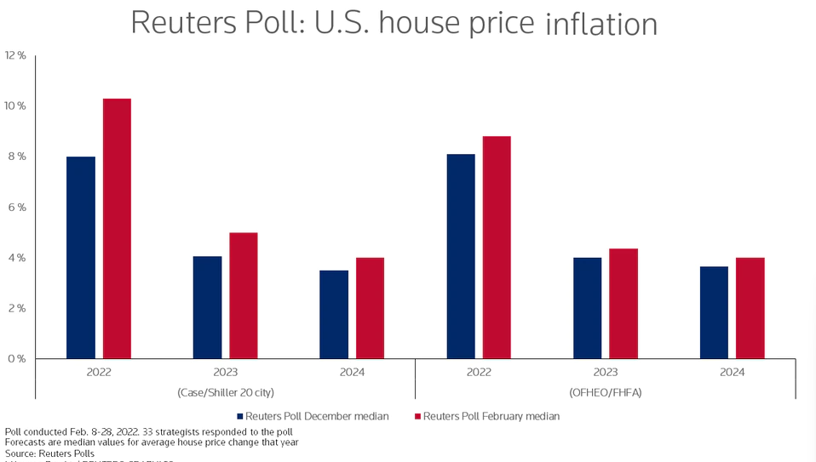
There are five components to consider when analyzing the residential home prices across the United States over the next decade:
1. Market: This is the most important factor in determining residential home prices. The market for residential homes is an important component to consider when assessing the future of home prices. The market consists of factors such as economic conditions, population demographics, housing affordability, and growth in technology. If there are not enough homes for people to buy or rent, then it will be difficult for houses to sell at a high price. The market is the most important factor in determining home prices. The market is a combination of demand and supply, which determines how much a house will sell for and what the average price per square foot of a house is. The great housing boom in the U.S. continues unabated after eight years of strong house price growth. It has been buoyed by continued low interest rates and by the government’s massive stimulus packages to cushion the impact of the pandemic. A limited supply of properties in the market has added to upward house price pressure.

Slide 11
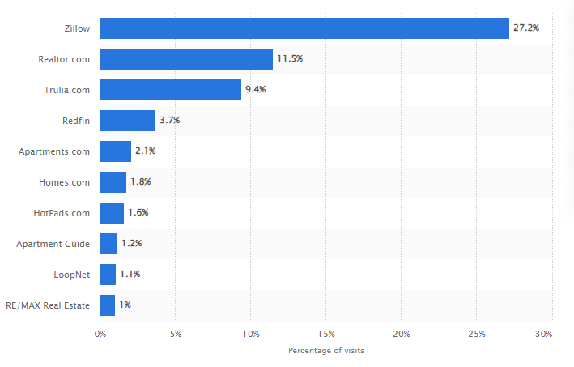
There are five components to consider when analyzing the residential home prices across the United States over the next decade:
2. Competitors: Competitors are another important factor to consider when assessing the future of residential home prices. In addition to other factors such as pricing strategies and distribution channels; competitors influence home prices by lowering costs through innovation and cost-cutting measures. If there are too many competitors in the market and they have more resources than you do, then it will be difficult for you to find customers willing to purchase your product or service. Competitors are an important consideration when calculating the value of a property. If you have many competitors within your area, the amount of money that you can charge for your services will be limited by their prices.
U.S. market share of leading real estate websites 2016 - Statista

Slide 12
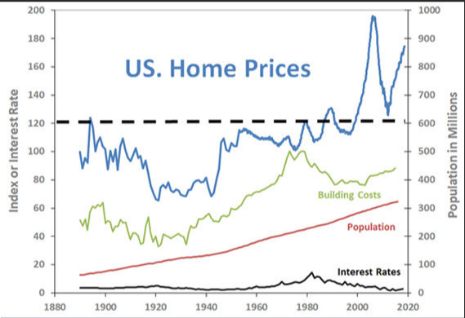
The United States housing market is booming, and it's only going to get bigger. According to Zillow, home values increased by an average of 6.5% in 2018 and are expected to reach $1 trillion by 2022. And while that's great for homeowners who can buy a new home or refinance their existing one, investors have been enjoying a windfall as well—and they're not showing any signs of slowing down just yet.
But what about everyone else? What will happen to the average homeowner's ability to get into a new house or even afford one? We spoke with several experts to find out how we can expect this boom cycle to affect Americans' financial lives over the next decade—and what we can do about it.
The first factor that is likely to influence real estate prices is demographics. The US population is aging quickly, and more people retiring means fewer renters looking for homes. In fact, according to an analysis from Harvard University's Joint Center for Housing Studies (JCHS), rents will increase as more people move into assisted living facilities or nursing homes instead of buying homes themselves—which means that if you want to live

Slide 13
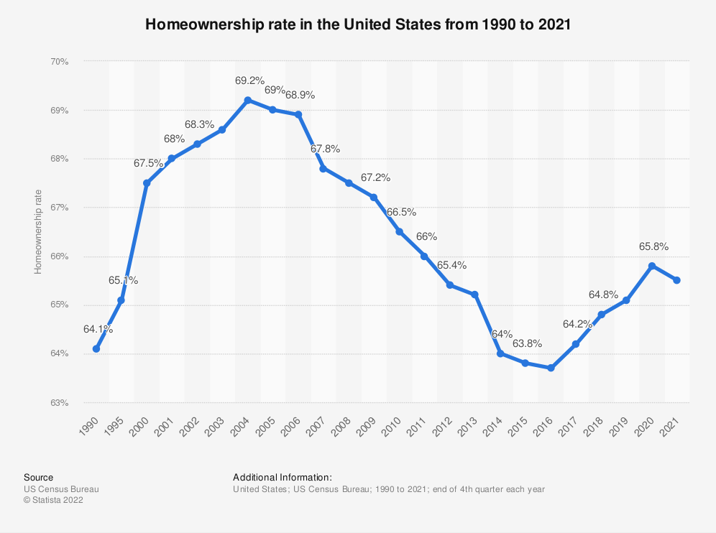
There are five components to consider when analyzing the residential home prices across the United States over the next decade:
3. Customers: Customers are also a significant contributor to residential home prices. Customer preferences influence home prices by influencing demand for particular product categories or styles. For example: If a customer prefers brick homes over brick ranch homes; this would have an impact on the price of brick ranch homes because these two styles sell for different amounts in the market place depending on their popularity among customers who prefer them over other styles or types of houses at different price points. If your customers are unable to pay what they owe on their mortgages, then they will not be able to purchase homes at high prices. Customers are another factor to consider when calculating the value of property. People who live in a certain area tend to be more wealthy than those who do not. This means that if you want to sell your house fast, you may need to offer higher prices than if you were trying to sell it slowly over time.

Slide 14
There are five components to consider when analyzing the residential home prices across the United States over the next decade:
4. Company: If your company cannot compete with other companies who offer similar products or services, then it will be hard for them to gain customers and therefore increase their profits through sales of goods and services related to residential homes (e.g., mortgages). Company size is also an important factor in determining how much a house will sell for because larger companies can afford more expensive advertising campaigns than small businesses do. This can influence how much customers are willing to pay for similar products or services from companies throughout the country, which influences how much houses will sell for across the country as well!

Slide 15

There are five components to consider when analyzing the residential home prices across the United States over the next decade:
5. Product: The product that influences residential home prices is primarily determined by its durability over time as well as its quality (i.e., how well it performs after being used by consumers). Product also plays an important role in determining residential home prices across the country over time due to changes in technology or consumer preferences over time period.

Slide 16
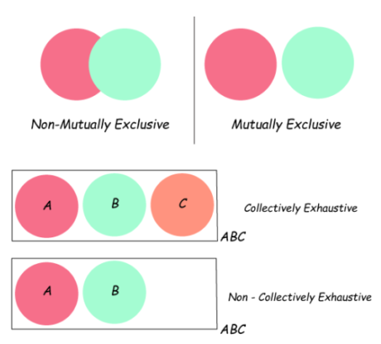
What does MECE mean?
MECE (pronounced “mee-see”) is short for Mutually Exclusive, Collectively Exhaustive. MECE is a principle for breaking down items into small pieces. “Mutually exclusive” means no overlap between each piece, while “collectively exhaustive” means all the pieces combined form the original item without any gap.
“MECE framework” is a common misnonym – MECE itself is not a framework, but a principle for frameworks. When a problem-solving framework is MECE, its branches must not have any overlap while covering all possible root causes.

Slide 17
3 Ways to Be MECE in Case Interviews
1. Algebra Structures
Algebra structures are a common strategy employed by case interviewers to test candidates' ability to reason through problems. They can be tricky for candidates to understand, but it's important to remember that algebra structures are meant to test your ability to identify and solve problems, not your understanding of the underlying concepts. The best way to prepare for algebra structures is to practice solving them on your own—try solving simple cases first, then move onto harder ones once you've gotten the hang of it. A good resource for practicing algebra structures is [link].
2. Process Structures
Process structures are another common strategy used by case interviewers and other hiring managers, though they tend to be more complex than algebra structures. These types of questions require you to use logic and reasoning skills in order to determine the best way forward or what needs to be done next in order for something else to succeed (or fail). There's no right answer here; just figure out how things work together, then choose what seems most appropriate based on that knowledge base!
3. Conceptual Frameworks:
You'll need to understand how concepts that relate to engineering apply in various situations when answering this type of question. For example, you may be asked how design principles relate to product development or marketing strategies and their effectiveness at engaging customers over time. What makes a good case study? How do you know if it's relevant to the role that you want? In order for your interviewers to provide feedback on your work—and for you to be able to make informed decisions about which cases are good fits for you—you need to have an idea of what they're looking for in any given job.

Slide 18
What can be done in the future to lessen the housing crisis?
According to the above all the factors and given data we can actually reduce the housing crisis in USA by applying some instant methods. As a result of the aforementioned issues and the information provided, it is possible to genuinely lessen the housing problem in the United States by the following methods:
• The housing tax would be more easily resolved if the government took the initiative and worked to address it.
• Help renters strengthen their finances and credit ratings so they may become homeowners.
• Innovation to construct more quickly, work more efficiently, and spend less money.

Slide 19


